Slide 1
A First Sample Program

Slide 2
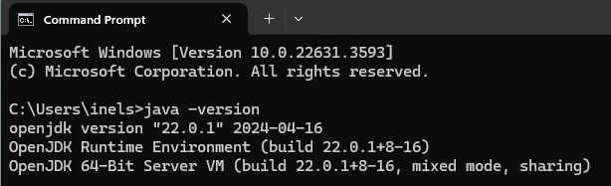
First Step – Make sure your tools are there
Download and install the OpenJDK 23.
Set the Environment variable and path for Open JDK23.
Download and install Notepad++.
Type cmd in the Search window of your computer to get a command prompt. Type java –version. Check what you get against this example:

Slide 3
Java Source Files
In Java, a source file is officially called a compilation unit. It is a text file that contains (among other things) one or more class definitions. (For now, we will be using source files that contain only one class.) The Java compiler requires that a source file use the .java filename extension.
The name of the class defined by the program is also Example. This is not a coincidence. In Java, all code must reside inside a class. In addition, the name of the main class should match the name of the file that holds the program. You should also make sure that the capitalization of the filename matches the class name. The reason for this is that Java is case-sensitive.

Slide 4
Create a Folder for your Project
Create a folder for your project. Name it something descriptive. Like LastnameExample.
It is not absolutely necessary to put your Java file(s) into a folder, but very soon, you will have multiple files for a project and you will need to turn in the entire folder.
So let’s start that way – it’s easier to find you files in a folder, too. ☺

Slide 5
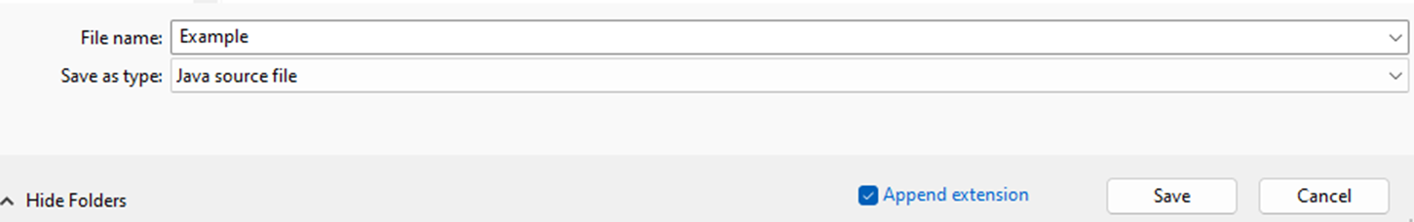
Create a File for the Program
Open Notepad++
Select File > New.
Save your file as Example.java and make sure the type of file is Java Source file.
You can check your file in the location where you saved it. It will display the name of the file and the type of the file will be JAVA File.

Slide 6

Open your File in Notepad++
Add a comment to the first two lines:
/*Ivonne Nelson inelson1@cm.edu
This is a Simple Program called Example.java */
Skip a line and on the next line, create the class then open and close braces.
class Example {
//Every program begins with a call to main()
public static void main(String[] args) {
System.out.println("This is a simple Java Program.");
}
}
****Most important, Save your code in Notepad++. *****
You can click on the save icon at right or use ctrl – s.

Slide 7
The main Method
For your main method, always use this:
public static void main(String[] args)
When a program starts, the computer looks for the main method and begins execution with the first statement after the main method heading.
This is the same main() that we used in C++ I.
It is the entry point of our application.

Slide 8
Braces
Use braces, { }, to group code.
In every program, the top and bottom braces group the contents of the entire class, and the interior braces group the contents of the main method.
There are two dominant styles used in Java:
K&R style (also called “Java” style)
C++ and C# style

Slide 9
Google Java Style
Braces are used with if, else, for, do and while statements, even when the body is empty or contains only a single statement.
Braces follow the Kernighan and Ritchie style(K & R) or ("Egyptian brackets"), like this:
public static void main(String[] args) {
System.out.println("This is a simple Java Program.");
}

Slide 10
C++ and C# Style for Braces
Place an opening brace on a line by itself in the same column as the first character of the previous line, then place a closing brace on a line by itself in the same column as the opening brace.
This style is perfectly acceptable and actually allows for better demarcation of a block of code.
public static void main(String[] args)
{
System.out.println("This is a simple Java Program.");
}

Slide 11
Which Brace Style is better?
Either one works. It is a matter of personal taste.
Choose the style you like and use it consistently.
Don’t change styles inside a project!!

Slide 12
Output to the Screen
Use System.out.println() to write to the screen.
For example, to print the hello message:
System.out.println("This is a simple Java Program.");
Note:
Put the printed item inside the parentheses.
Surround string literals with quotes.
Put a semicolon at the end of a System.out.println statement.
Don’t forget the two closing braces!
Save your file!!!

Slide 13
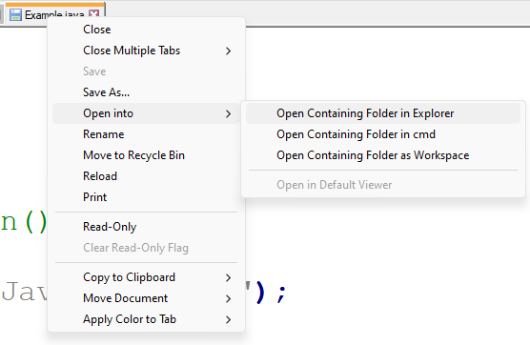
Open your project in CMD
Right-click on the name of your file to see this dialog and select Open into > Open Containing Folder in cmd.

Slide 14
Compile and Run your Project.
At the command prompt, type:
javac Example.java
The javac compiler creates a file called Example.class that contains the bytecode version of the program.
To actually run the program, you must use the Java application launcher called java. To do so, pass the class name Example as a command-line argument
java Example

Slide 15
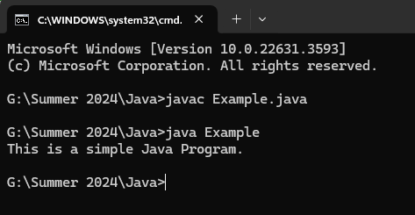
Your Output

Slide 16
What Just Happened
When Java source code is compiled, each individual class is put into its own output file named after the class and using the .class extension.
When you execute java as just shown, you are actually specifying the name of the class that you want to execute.
It will automatically search for a file by that name that has the .class extension and will execute the code contained in the specified class.
Look in your project folder to see the .class file.

Slide 17
Note: Shortcut From SDK 11
This how Java programs have been compiled and run since Java’s beginning, and it is the method that you will use when developing applications.
However, beginning with JDK 11, it is possible to compile and run some simple Java programs directly from the source file without having to first invoke javac:
java Example.java
This causes java to automatically invoke the compiler and execute the program.
Be aware, however, that no .class file is created. Instead, the compilation is done behind the scenes.
As a result, to rerun the program, you must execute the source file again. You can’t execute its .class file because one won’t be created.

